Slide 1

Saber Ebrahimnejad
Sarina Hamedani
Lab Project 2:
System Calls and Processes

Slide 2
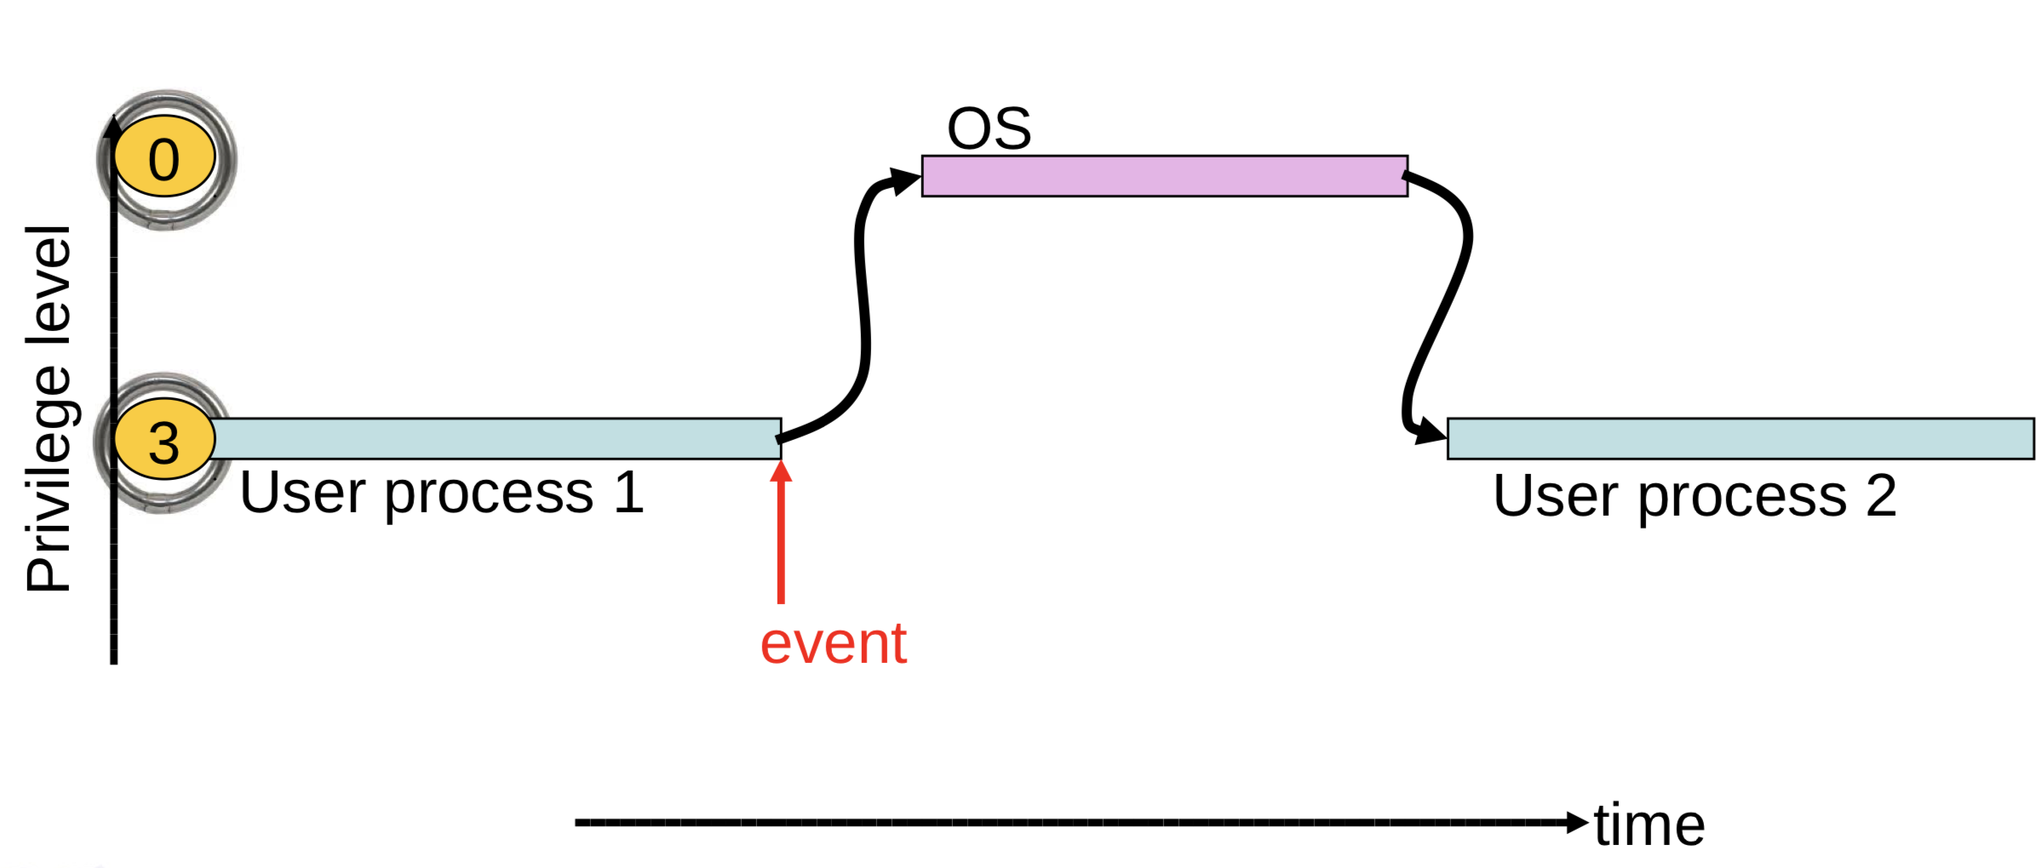
Why Event Driven Design?
OS cannot trust user processes
User processes may be buggy or malicious
User process crash should not affect OS
OS needs to guarantee fairness to all user processes
One process cannot 'hog' CPU time
Timer interrupts

Slide 3
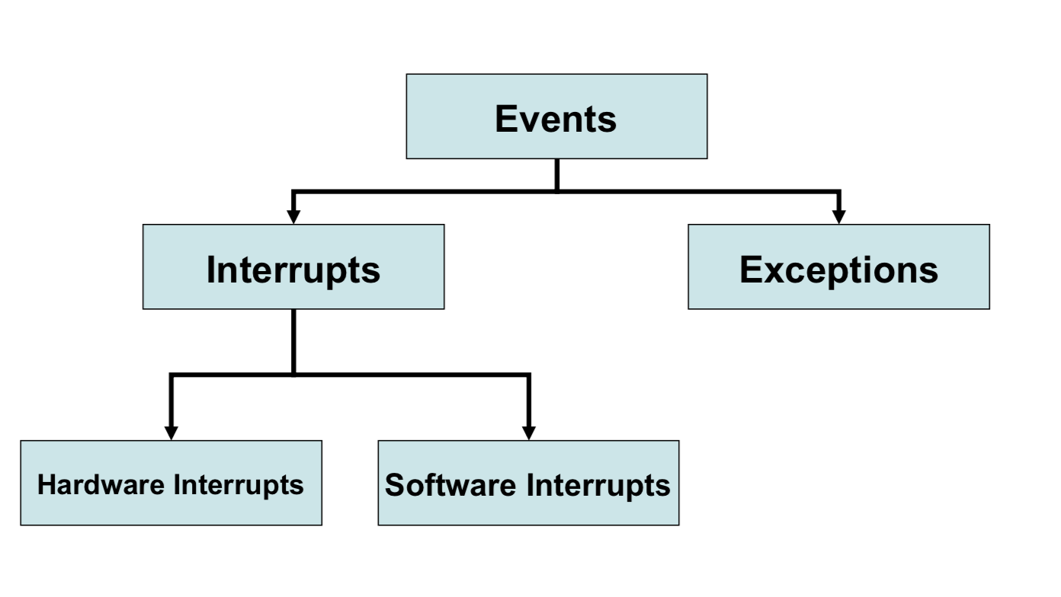
Event Types

Slide 4
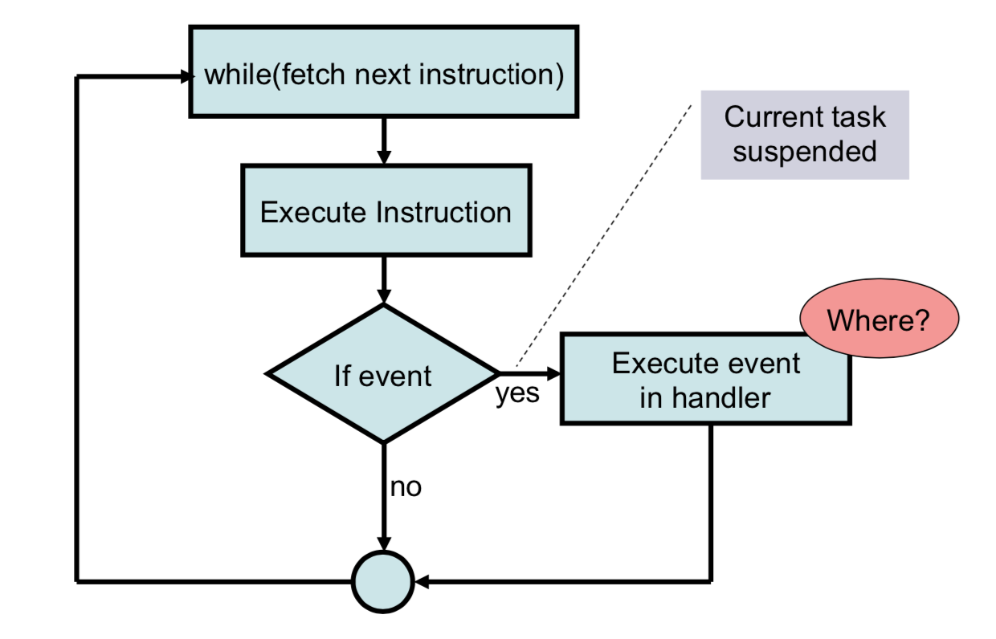
Event View of CPU

Slide 5
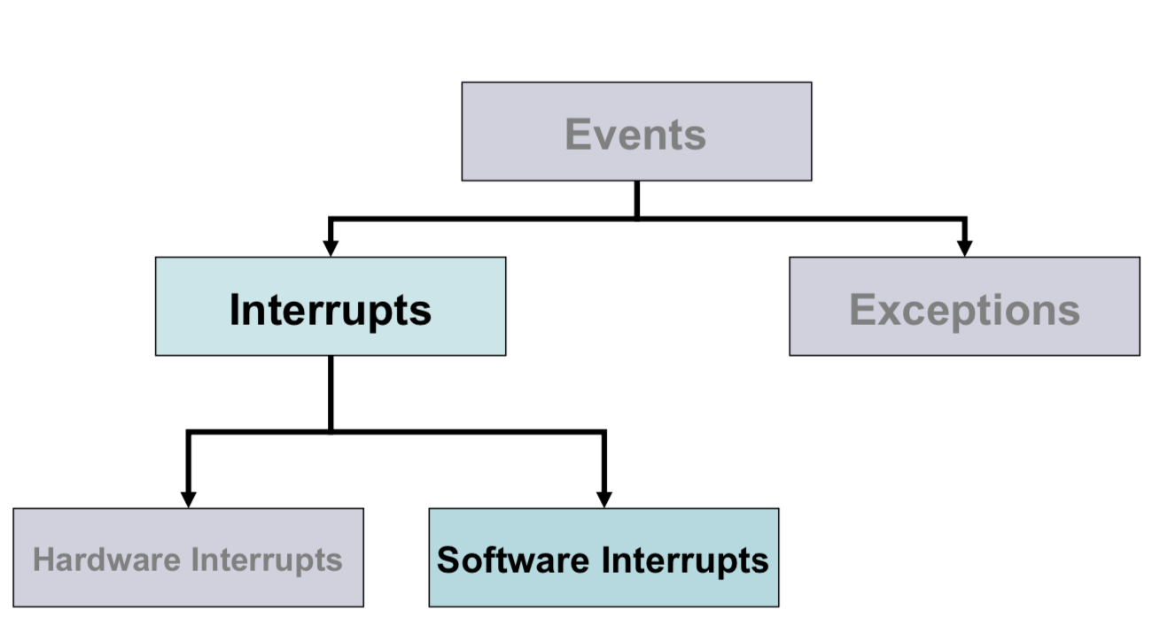
System Calls

Slide 6
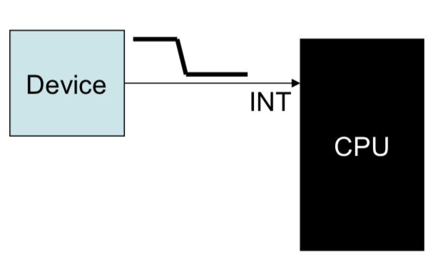
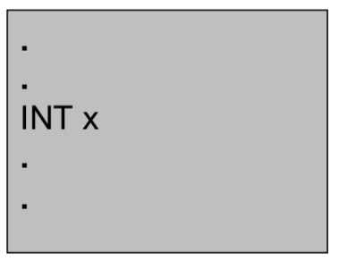
Hardware vs Software Interrupt
Hardware Interrupt
A device (like PIC) asserts a pin in the CPU
Software Interrupt
An instruction which when executed causes an interrupt

Slide 7
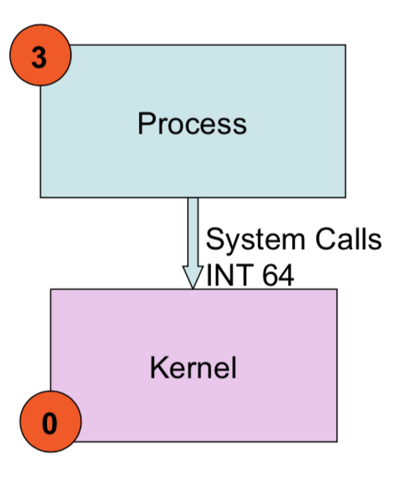
Software Interrupt
Software interrupt used for implementing system call
Previously in Linux INT 128, was used for system calls
In xv6, INT 64 is used for system calls

Slide 8
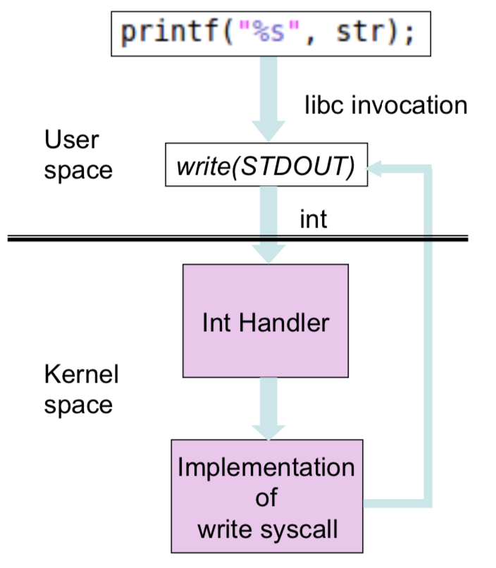
Example: Write System Call

Slide 9
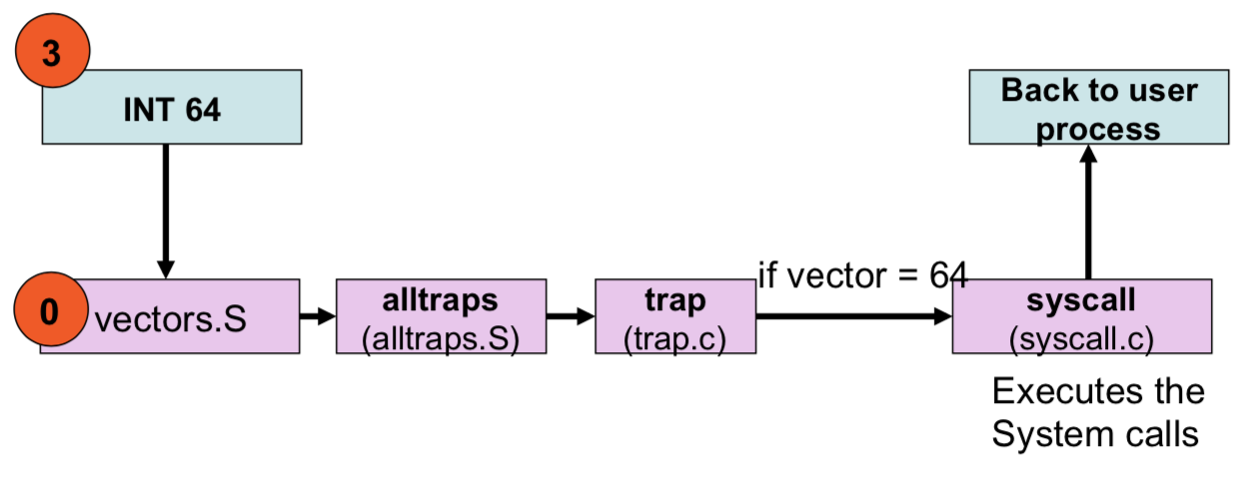
System Call Processing in kernel
Almost similar to hardware interrupts

Slide 10
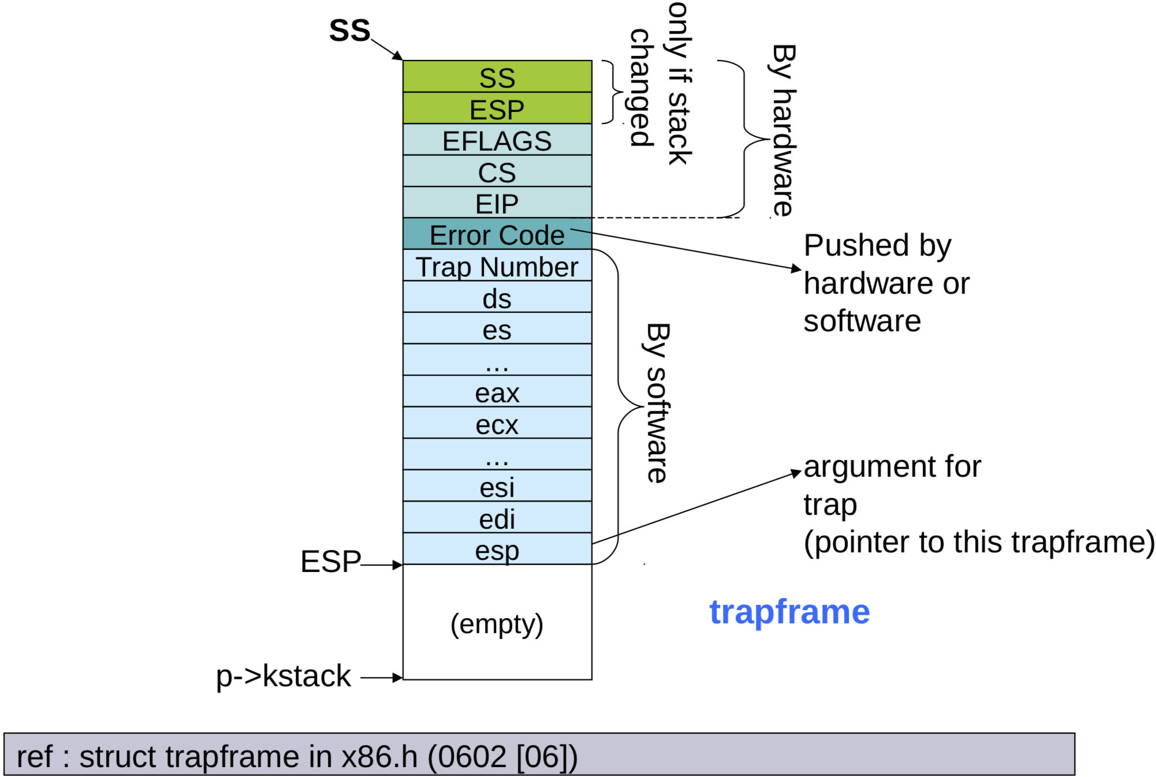
Trapframe

Slide 11
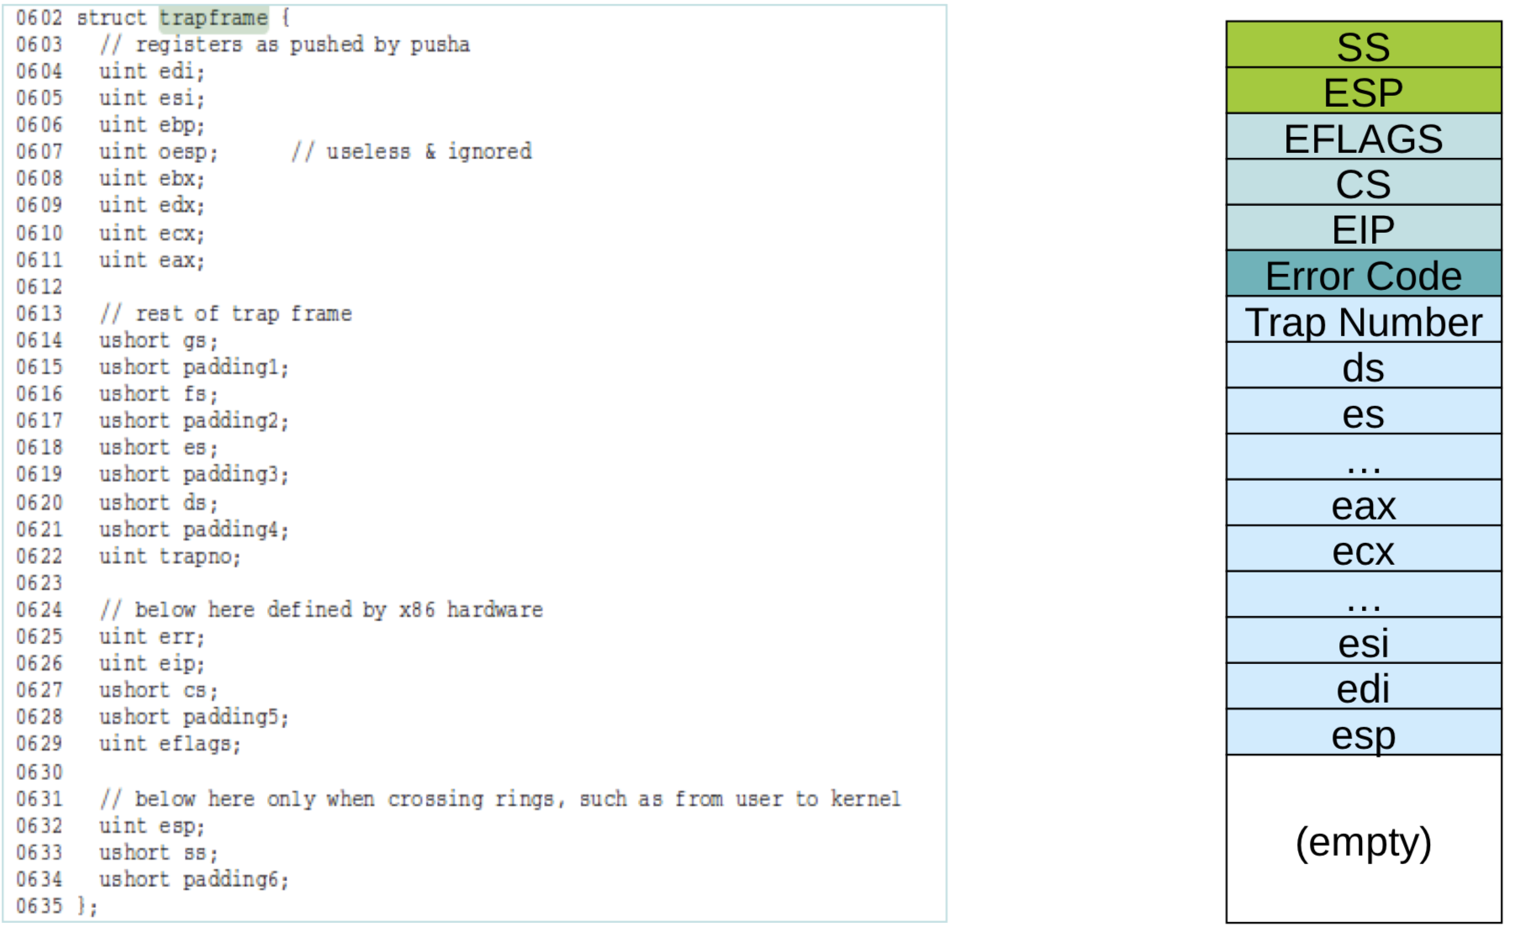
Trapframe Struct

Slide 12
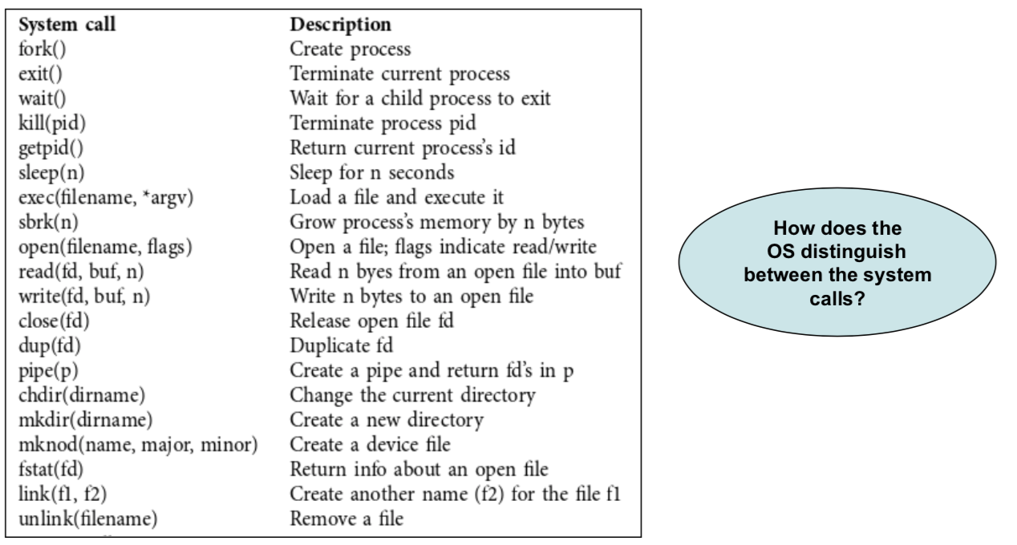
System Calls in xv6

Slide 13
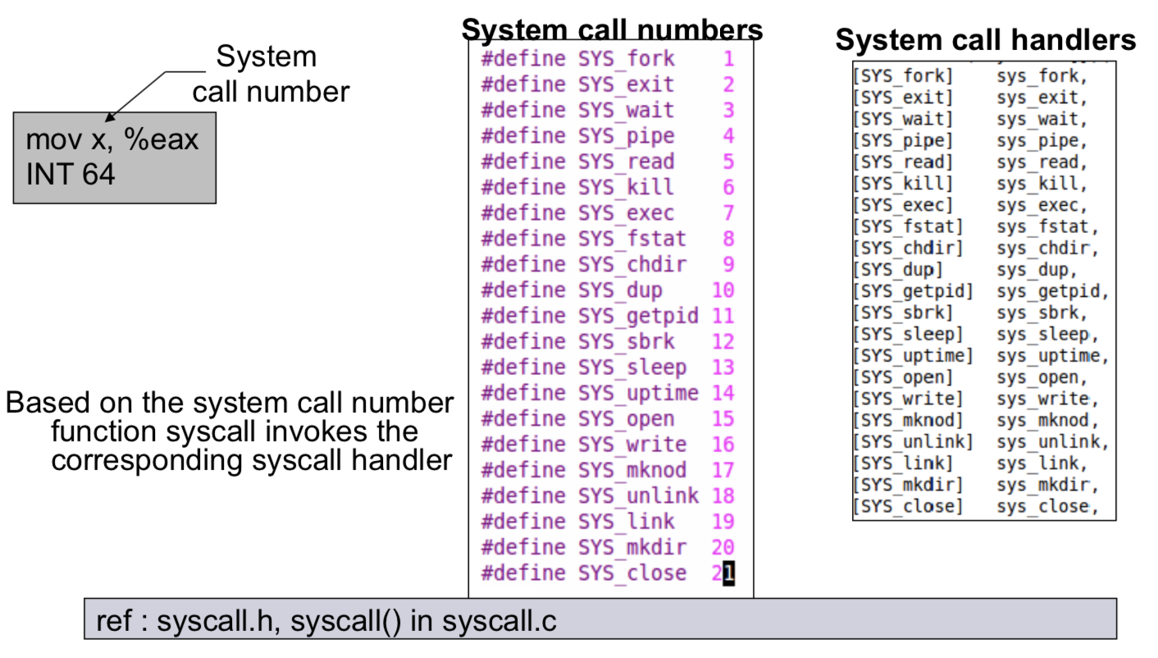
System Call Number

Slide 14
xv6 System Call Naming Convention
Usually a library function foo() will do some work and then call a system call sys_foo()
sys_foo() implemented in sys*.c (sysfile.c, sysproc.c)
System call number for foo() is SYS_foo
syscalls.h
All system calls begin with sys_

Slide 15
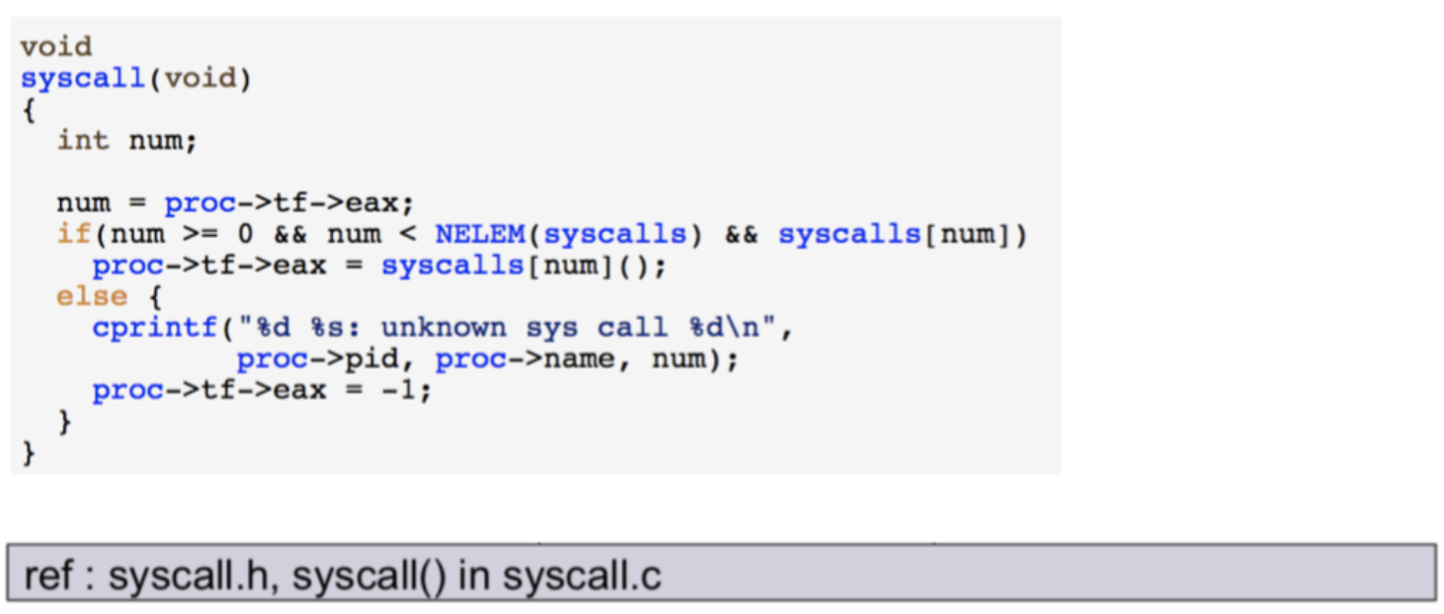
Syscall(void)
All system calls are handled in this function. The sys num which is saved in eax register is retrieved and system call is read from table.

Slide 16
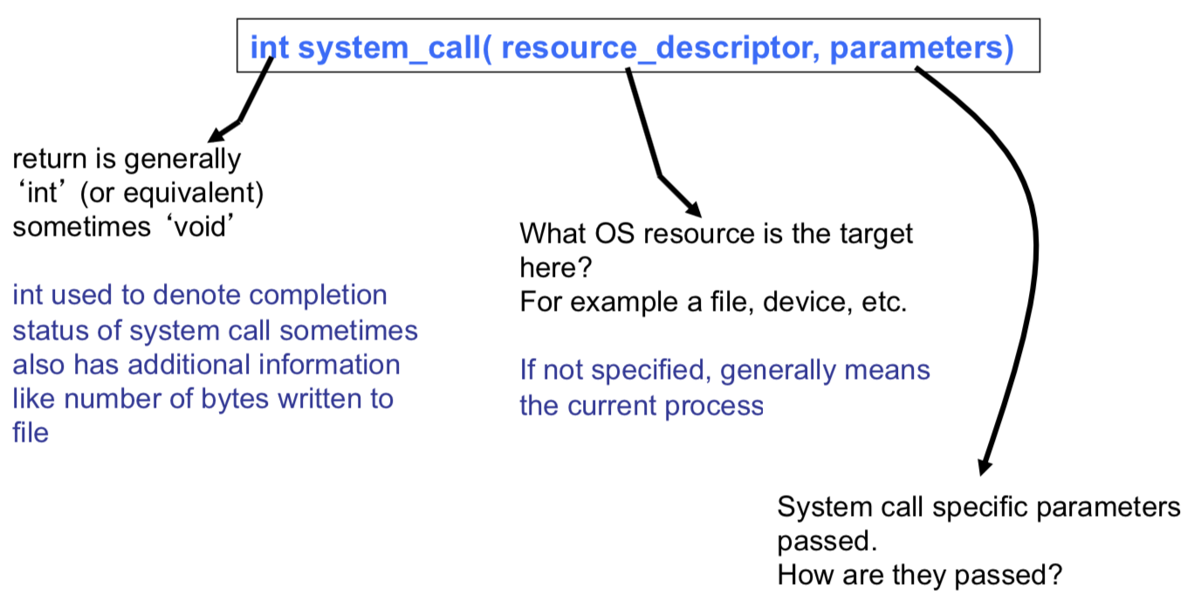
Prototype of a Typical System Call

Slide 17
Adding New System Call
A system call body is defined in sysproc.c or sysfile.c
Multiple files are needed to be altered to add a new syscall.
Desired new system calls in this project:
void calculate_sum_of_digits (int num)
void get_file_sectors(int fd)
void get_parent_id()
void set_process_parent(int pid)

Slide 18
Processes
A process is the running of a program, including the program's state and data. The state includes such things as:
Memory the program occupied
Memory contents
Register values
Files
Kernel structures

Slide 19
Managing Processes
The kernel has a simple data structure for each process, organized in some list. The kernel juggles between the processes, using a context switch, which:
Saves state of old process to memory.
Loads state of new process from memory
The processes are held in a struct named ptable, who has a vector of processes named proc.

Slide 20
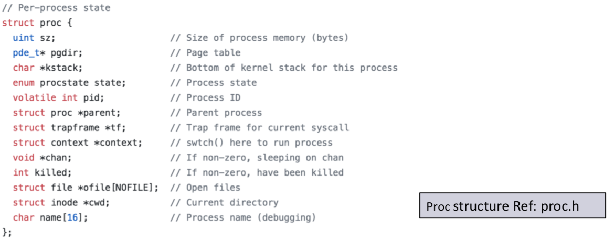
First Process
Processes are created by the kernel, after another process asks it to. Therefore, the kernel needs to run the first process itself, in order to create someone who will ask for new processes to be created.

Slide 21
Passing Parameters in System Calls
Passing parameters to system calls not similar to passing parameters in function calls
Recall stack changes from user mode stack to kernel stack.
Typical Methods
Pass by Registers (eg. Linux)
Pass via user mode stack (eg. xv6)
Complex
Pass via a designated memory region
Address passed through registers

Slide 22
Pass By Registers (Linux)
System calls with fewer than 6 parameters passed in registers
%eax (sys call number), %ebx, %ecx,, %esi, %edi, %ebp
If 6 or more arguments
Pass pointer to block structure containing argument list
Max size of argument is the register size (eg. 32 bit)
Larger pointers passed through pointers

Slide 23
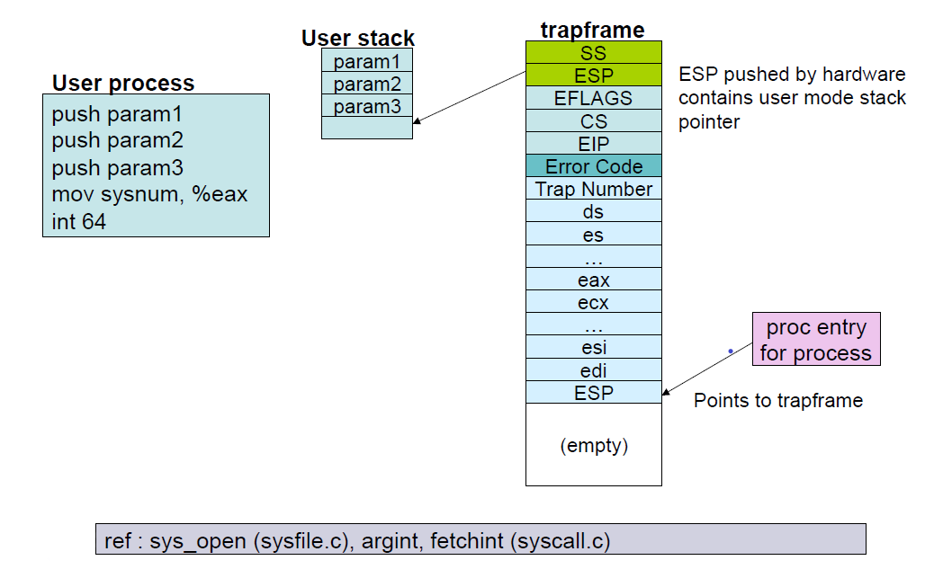
Pass via User Mode Stack (xv6)

Slide 24
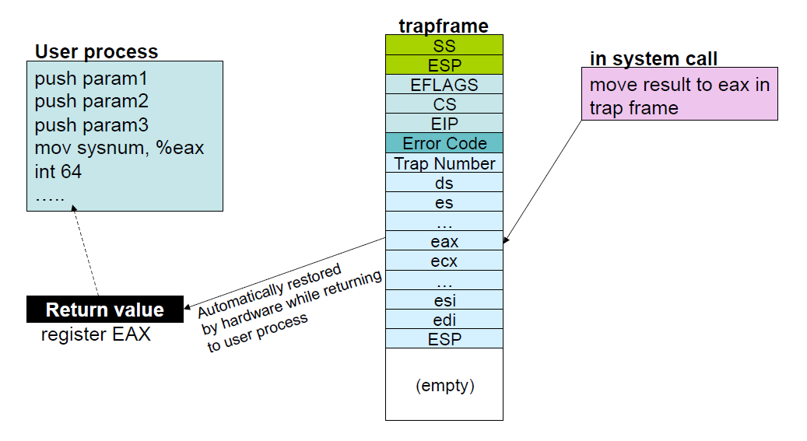
Return from System Calls

Slide 25

Calculate Sum of Digits
int calculate_sum_of_digits(int num)
Get number as argument
Use a register to store the argument
Return the sum value of all digits in num

Slide 26
On-Disk File System Structure (UNIX)
Disk space divided into inode and data regions
inodes contain critical metadata about the file
stat attributes
pointers to data blocks
...
Data regions divided into much larger (typically 8KB or more) data blocks
Contain file data and directory metadata
Files and directories logically consist of a series of data blocks, which may be scattered throughout the disk.

Slide 27
Sectors and Blocks
Most disks can only perform reads and writes in units of sectors (512 bytes each)
File systems allocate and use disk storage in units of blocks
sector size: property of disk hardware
block size: aspect of OS using the disk
xv6 file system uses a block size of 512 bytes, the same as the sector size of the underlying disk

Slide 28
Superblocks
Metadata describing properties of file system as a whole
Block size
Disk size
Any metadata to find root directory
time the file system was last mounted
time the file system was last checked for errors
Reserved at "easy-to-find" locations on disk (start or end)

Slide 29
Get File Sectors System Call
void get_file_sectors(int fd)
Get a file descriptor as argument
Print the block number on disk for each block of the file
Hint: find a function that maps file block numbers to block address

Slide 30
Print Parent PID
void get_parent_id()
Print the parent process id of the currently running process

Slide 31
Set Process Parent
void set_process_parent(int pid)
Get process id as argument
Set the currently running process as the parent of input process (pid)
Implement in a way that real parent can be distinguished from unreal one

Slide 32
Deadline
Deadline: 23 Aban
Provide Report
Resources: http://www.cse.iitm.ac.in/~chester/courses/16o_os/slides/6_Interrupts.pdf

